Slide 1

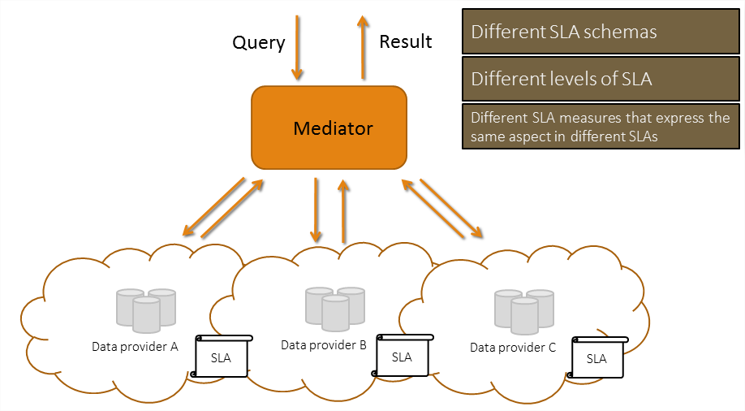





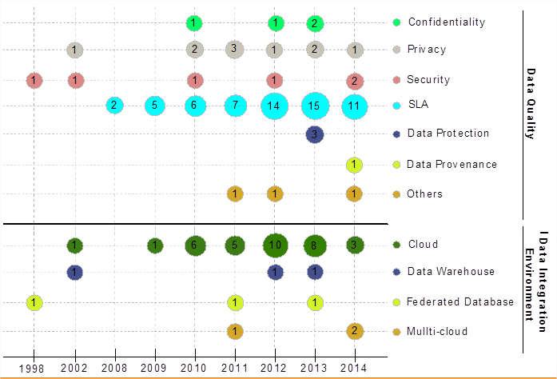
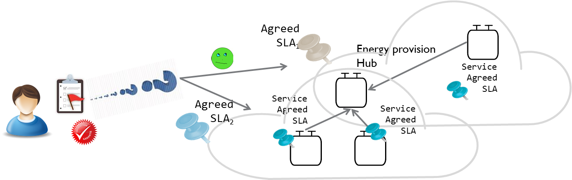




Mondes numériques pour l’humain et la société : conception, comportements et usages
ARC 6 : Technologies de l’Information et de la Communication
et Usages Informatiques Innovants
Trusted SLA-Guided Data Integration on Multi-cloud Environment
The emergence of cloud computing opens new challenges to data integration:
The possibility of an unlimited access to resources changes the problems associated to data processing
The definition of requirements and obligations between the provider and customer through service level agreement (SLA).
Approaches combining SLA and data integration have not been enough explored in the literature.
General Objective: Propose a data integration approach in a multi-cloud environment guided by user preferences and SLA
POINTS CLES
TRAVAUX ENGAGES / RESULTATS
Model quality measures linked to data and to cloud resources
Use Service Level Agreement (SLA) for guiding the data integration process performed on a multi-cloud
Match data providers (services) to queries for integrating data according to the user requirements and the SLAs.
Problem statement and state of the art by applying a
systematic mapping process
Rhône algorithm: formalization and implementation of a quality-based query rewriting considering user preferences and quality aspects expressed as SLA contracts.
SLA schema: designing and modeling of the different schemas of SLA contracts.
Query definition: formalization of the different type of query variations according to the user requirements, and proposed solution for each case.
Heuristics: proposal of heuristics applied to the new context in order to reuse as much as possible previous results in a further integration.
____________
D. A. S. Carvalho, P. A. Souza Neto, G. Vargas-Solar, N. Bennani, C. Ghedira, Can Data Integration Quality be Enhanced on Multi-cloud using SLA?, In 26th Int. Conf. on Database and Expert Systems Applications, Spain, 2015.
D. A. S. Carvalho, P. A. S. Neto, C. Ghedira, G. Vargas-Solar, N. Bennani. Rhone: a quality-based query rewriting algorithm for data integration.. East-European Conference on Advances in Databases and Information Systems, Aug 2016, Prague, France. ADBIS East-European Conference on Advances in Databases and Information Systems, 2016.
D. A. S. Carvalho, P. A. S. Neto, C. Ghedira, G. Vargas-Solar, N. Bennani. Towards Quality Guided Data Integration on Multi-Cloud Settings. 14th international conference on service oriented computing (ICSOC), Oct 2016, Banff, Alberta, Canada.
Defining research
questions
Conduct search on
scientific databases
Selecting papers
Keywording using
abstracts
Data extraction and
Mapping process
Defining the scope
Retrieving papers
(conjunctive/disjunctive query)
Relevant papers
(analyzing titles and abstracts)
Producing a
classification scheme
Generating mapping
results
PROBLEMATIQUE
Results*
Database | Amount | Included | Excluded
IEEE | 658 | 56 | 602
ACM | 649 | 31 | 618
Science Direct | 106 | 6 | 100
CiteSeerX | 419 | 21 | 398
Total | 1832 | 114 | 1718
Efficiently obtain results for queries addressing services deployed in a multi-cloud environment by:
  Fulfilling user QoS requirements
  Respecting subscribed contracts with the involved cloud provider(s),
  Respecting services contracts (constraints).
Challenges:
How to be sure that all the agreed SLAs are respected while satisfying the user?
Can my constraints be satisfied? Which services shall I ask for?
How can resources be saved for next query?
How to perform the query rewriting matching services that answer the query and satisfy the quality preferences?
How to integrate different SLA associated to services involved with user’s quality preferences?
Daniel Aguiar da Silva Carvalho, Magellan, IAE, Univ. J-Moulin Lyon 3 - France
Chirine Ghedira Guegan, Magellan, IAE, Univ. J-Moulin Lyon 3 - France
Nadia Benani, CNRS INSA-Lyon, LIRIS, UMR5205 - France
Genoveva Vargas-Solar, CNRS, LIG-LAFMIA, Saint Martin d'Hères - France

